Slide 1
3. Association rule mining
Overview
Market basket analysis
Frequent item sets
Association rule mining
A priori property
Lesson learning outcome
Identify applications of association rule mining
Compute support and confidence of a dataset
Explain the Apriori property
Demonstrate the application of Apriori algorithm

Slide 2
Introduction
When we go grocery shopping, we often have a standard list of things to buy.
Each shopper has a distinctive list, depending on one’s needs and preferences.
A housewife might buy healthy ingredients for a family dinner, while a student might buy chips and coke.
Understanding these buying patterns can help to increase sales in several ways.

Slide 3
Introduction (contd.)
If there is a pair of items, X and Y (lets say ice cream and strawberries), that are frequently bought together:
  Both ice cream and strawberries can be placed on the same shelf, so that buyers of one item would be prompted to buy the other.
  Promotional discounts could be applied to just one out of the two items.
  Advertisements on ice cream could be targeted at buyers who purchase strawberries.
  Ice cream and strawberries could be combined into a new product, such as having strawberry in flavors of ice cream.

Slide 4
Association rule mining
Market Basket Analysis is one of the key techniques used by large retailers to uncover associations between items.
It allows retailers to identify relationships between the items that people buy.
Market Basket Analysis works by looking for combinations of items that occur together frequently in transactions.
Association Rules are widely used to analyze retail basket or transaction data, and are intended to identify relationships in transaction data.

Slide 5
Item set
A set of items is referred to as itemset
An itemset containing k items is called k-itemset
An itemset can be seen as a conjunction of items

Slide 6
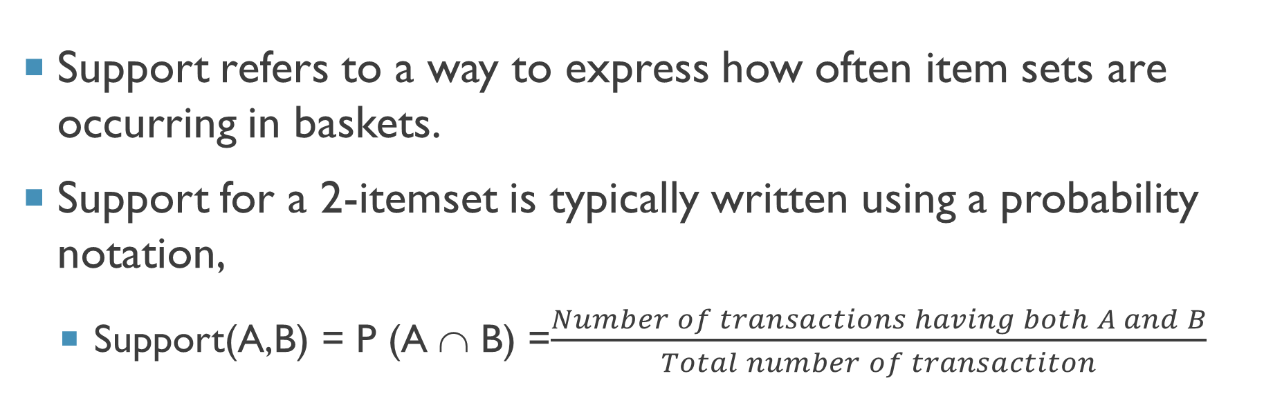
support
Support refers to a way to express how often item sets are occurring in baskets.
Support for a 2-itemset is typically written using a probability notation,
  Support(A,B) = P (A ∩ B) =$\frac{Number of transactions having both A and B}{Total number of transactiton}$

Slide 7
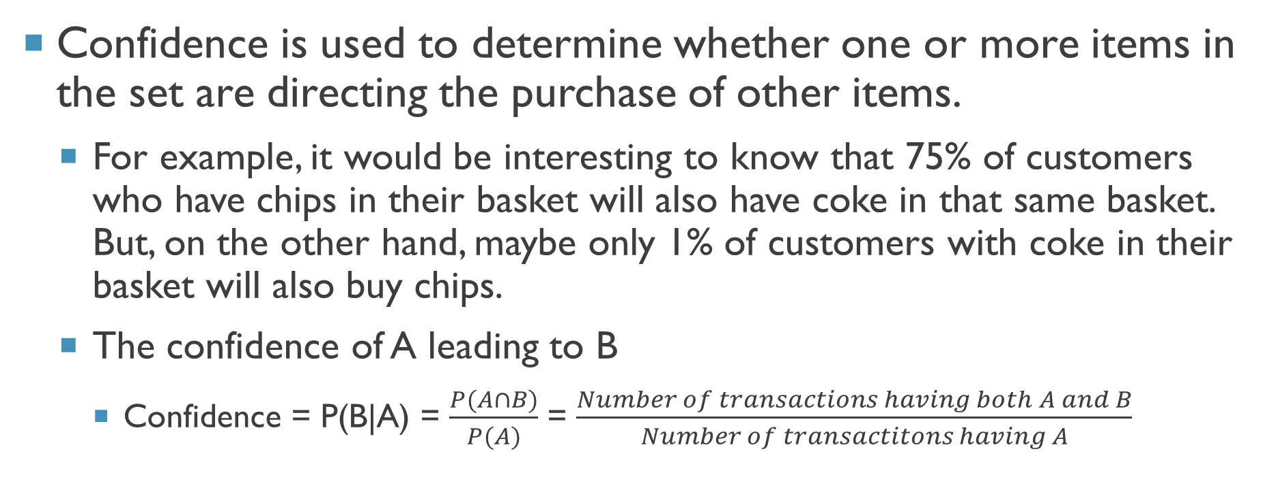
Confidence
Confidence is used to determine whether one or more items in the set are directing the purchase of other items.
  For example, it would be interesting to know that 75% of customers who have chips in their basket will also have coke in that same basket. But, on the other hand, maybe only 1% of customers with coke in their basket will also buy chips.
  The confidence of A leading to B
    Confidence = P(B|A) = $\frac{P(A∩B)}{P(A)}$ = $\frac{Number of transactions having both A and B}{Number of transactitons having A}$

Slide 8
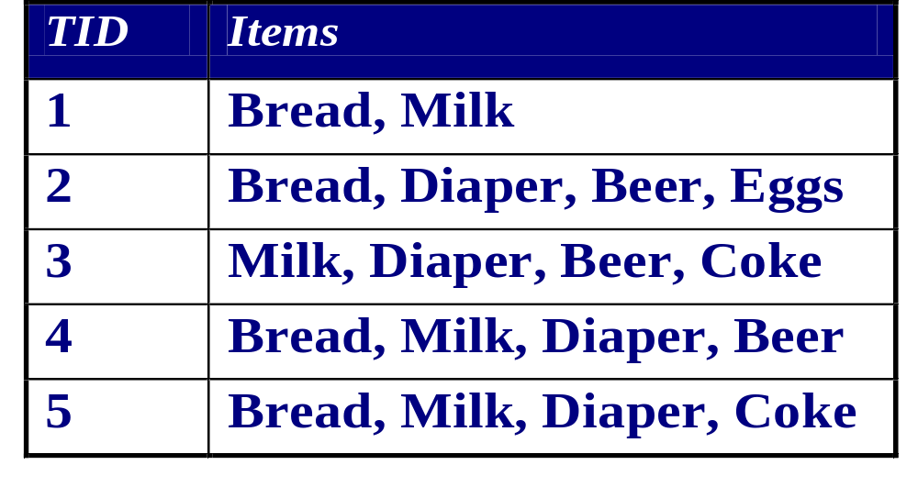
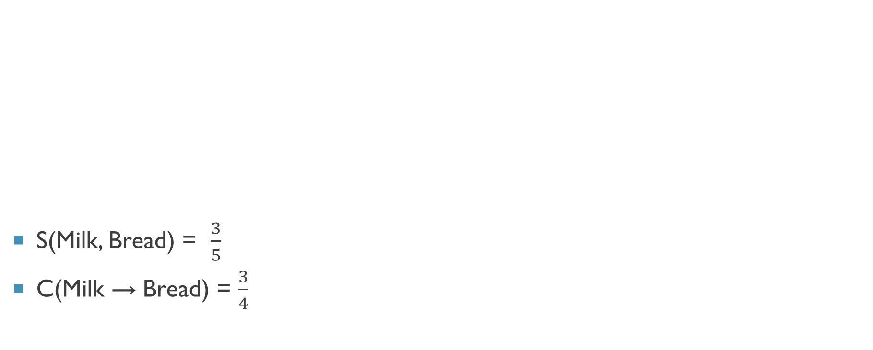
Computing support and confidence
S(Milk, Bread) = $\frac{3}{5}$
C(Milk → Bread) = $\frac{3}{4}$

Slide 9
Frequent item sets
Suppose min_sup is the minimum support threshold set for a set of transactions
If frequency of an itemset is greater or equal to min_sup the itesmset satisfies the minimum support
If an itemset satisﬁes minimum support, then it is a frequent itemset

Slide 10
Association rules
An association rule takes the form if A, then B (i.e., A⇒B)
Rules that have either high support or high confidence, and usually both are preferred to make a conclusion
Strong rules are those that meet or surpass certain minimum support and confidence criteria.
  For example, an analyst interested in finding which supermarket items are purchased together may set a minimum support level of 20% and a minimum confidence level of 70%.

Slide 11
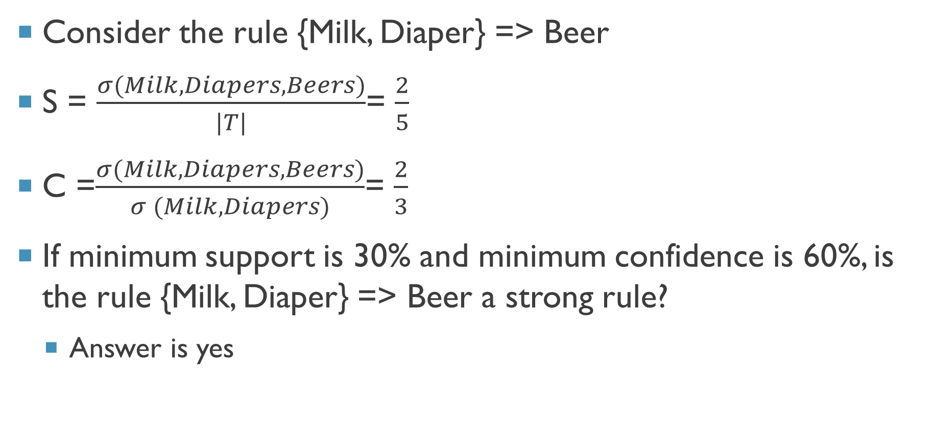
Frequent item sets
Consider the rule {Milk, Diaper} => Beer
S = $\frac{σ(Milk, Diapers, Beers)}{|T|}$= $\frac{2}{5}$
C =$\frac{σ(Milk, Diapers, Beers)}{σ (Milk,Diapers)}$= $\frac{2}{3}$
If minimum support is 30% and minimum confidence is 60%, is the rule {Milk, Diaper} => Beer a strong rule?
  Answer is yes

Slide 12
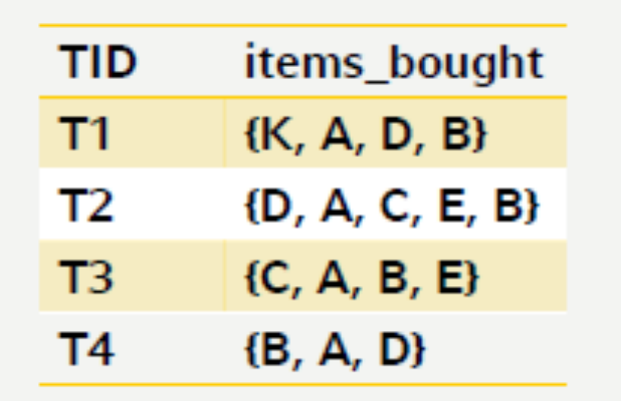
Exercise 1
Consider the Rule A=>D
Find the support and confidence for the rule
If minimum support is 50% and minimum confidence 70% is the rule a strong rule?

Slide 13
Association rule mining
The mining of association rules from large databases is a two-step process:
  Find all frequent itemsets
  From the frequent itemsets, generate association rules satisfying the minimum support and confidence conditions.
Frequent itemset generation is computationally expensive…!!!

Slide 14
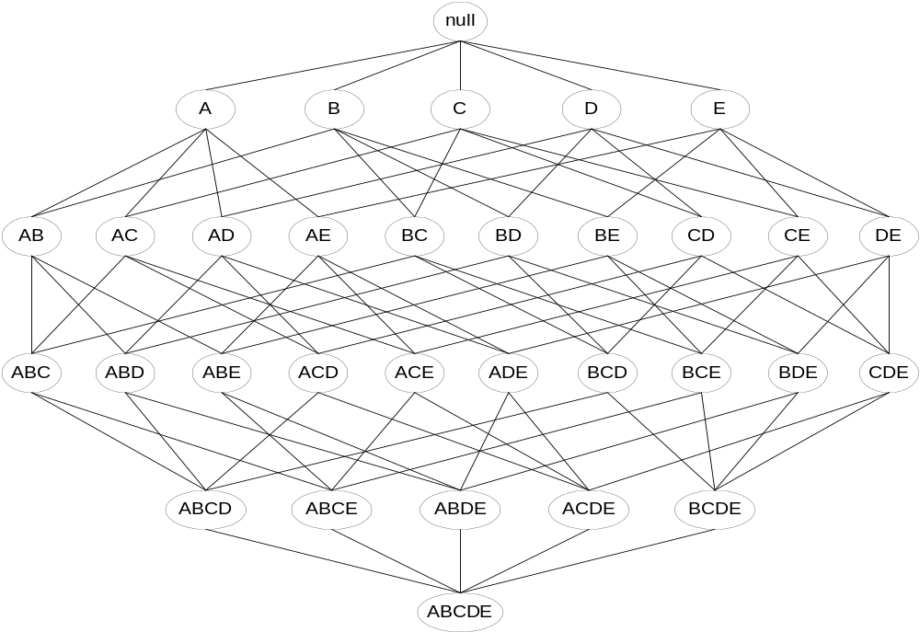
Possible item sets for five items
Given d items, there are 2^{d} possible candidate itemsets

Slide 15
A Priori property
The a priori algorithm takes advantage of the a priori property to shrink the search space.
The a priori property states that if an itemset Z is not frequent, then adding another item A to the itemset Z will not make Z more frequent.
This helpful property reduces significantly the search space for the a priori algorithm.

Slide 16
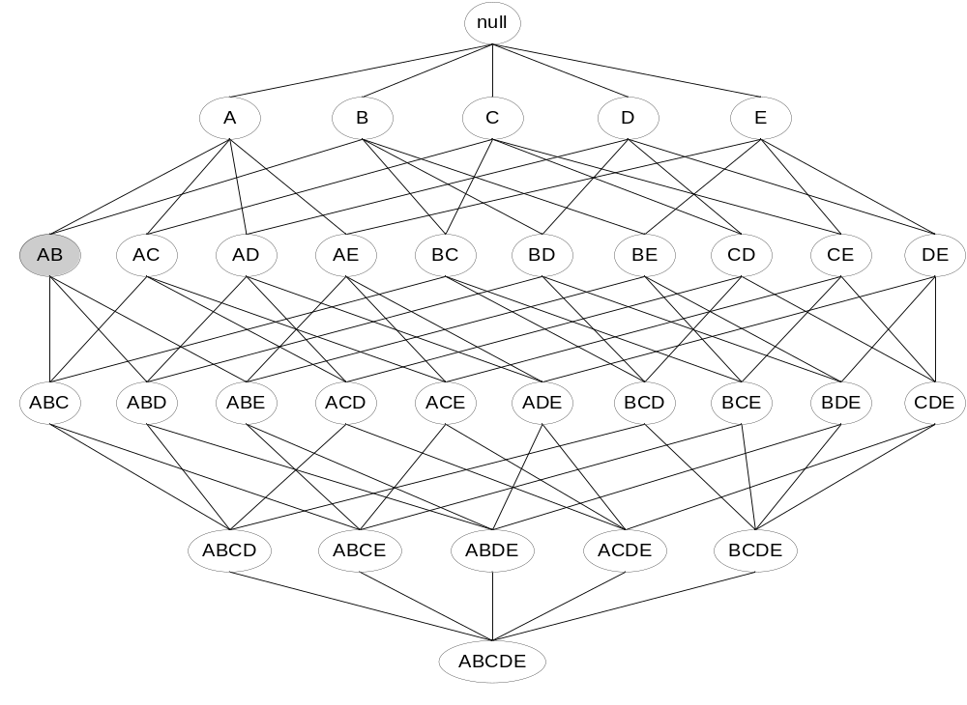
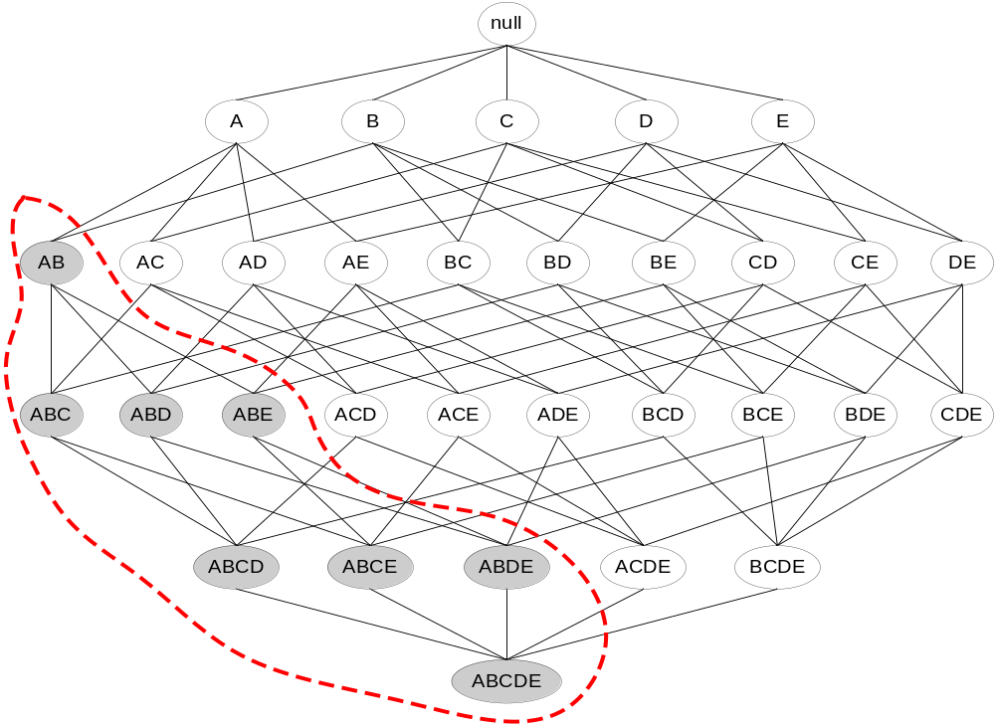
A priori property (Contd.)
Found to be Infrequent
Pruned supersets

Slide 17
An Example
Minimum support – 60 %
itemset | count
Bread | 4
Coke | 2
Milk | 4
Beer | 3
Diaper | 4
Eggs | 1
Item set | Count
Bread, milk | 3
Bread, Beer | 2
Bread, Diaper | 3
Milk, Beer | 2
Milk, Diaper | 3
Beer, Diaper | 3
Item set | Count
Bread, milk, Diaper | 2
3- Item sets
1- Item sets
2- Item sets

Slide 18
Apriori algorithm
    C_{k}: Candidate itemset of size k
    L_{k} : frequent itemset of size k
    L₁ = {frequent items of size 1};
    for (k = 1; L_{k} !=∅; k++) do begin
    C_{k+1} = candidates generated from L_{k} based on Apriori property
    for each transaction t in database do
    increment the count of all candidates in Ck+1 that are contained in t
    L_{k+1} = candidates in C_{k+1} with min_support
    end
    return ∪_{k} L_{k};

Slide 19
An example
Minimum Support – 60%
TID | Items
1 | 1, 3, 4
2 | 1, 2, 3, 4
3 | 2, 4
4 | 1, 2, 4
5 | 1,3, 4, 5
Itemset | support
{1} | 4
{2} | 3
{3} | 3
{4} | 5
Itemset | Support
{1, 2} | 2
{1, 3} | 3
{1, 4} | 4
{2, 3} | 1
{2, 4} | 3
{3, 4} | 3
Itemset | Support
{1, 3} | 3
{1, 4} | 4
{2, 4} | 3
{3, 4} | 3
L1
L2
Database
C2
Itemset | support
{1,3 ,4} | 3
Itemset | support
{1,3 ,4} | 3
C3
L3

Slide 20
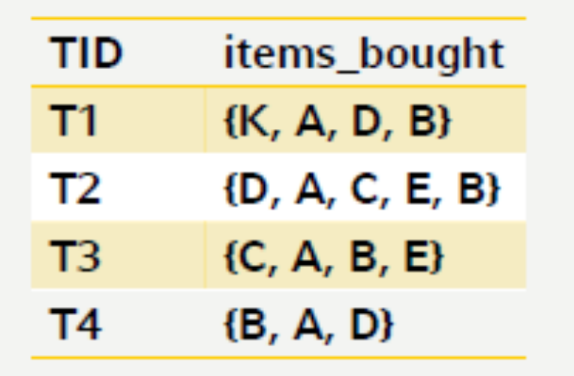
Exercise 2
Let 𝐷 be a database that contains the following four transactions:
  minSup=60%.
Find all frequent itemsets using the Apriori algorithm

Slide 21
Generating association rules
First, generate all subsets of frequent item set s.
Then, let ss represent a nonempty subset of s.
Consider the association rule R: ss⇒(s − ss), where (s − ss) indicates the set s without ss.
Generate (and output) R if R fulfills the minimum confidence requirement.
Do so for every subset ss of s.

Slide 22
Example
Possible association rules using L2
  1→3, 1→4, 2→4, 3→4, 3→1, 4→1, 4→2, 4→3
Possible association rules using L3
  1→34,3→14,4→13, 13→4, 14→3, 34→1
Find the rules which are supporting the minimum confidence level to identify strong rules
Itemset | Support
{1, 3} | 3
{1, 4} | 4
{2, 4} | 3
{3, 4} | 3
Itemset | support
{1,3 ,4} | 3

Slide 23
Exercise 2
Find all the possible association rules in the dataset.
Find association rules with two items which are having minimum confidence of 80%

Slide 24
Disadvantages of apriori algorithm
  Generation of candidate itemsets is expensive(in both space and time)
  Support counting is expensive
    Subset checking (computationally expensive)
    Multiple Database scans (I/O)

